Slide 1
Fuzzy set
Session 15
Felix Indra Kurniadi, S.Kom., M.Kom.

Slide 2
Learning Outcomes
Session 15
At the end of this session, students will be able to:
LO 4: Apply various techniques to an agent when acting under certainty

Slide 3
outline
Session 15
Fuzzy Logic
Crisp Set vs Fuzzy Set
Membership Function
Standard Operation of Fuzzy Set

Slide 4
Fuzzy Logic
definition
Fuzzy logic is one of the foundations of modern computer development.
Fuzzy logic is a logic that represents vague values, uncertainty, partial truth or "degree of truth".
Fuzzy logic is a development of Boolean logic which is only worth 0 and 1.
Fuzzy logic was first developed by Prof Lotfi Aliasker Zadeh through his paper on Fuzzy Set Theory.

Slide 5
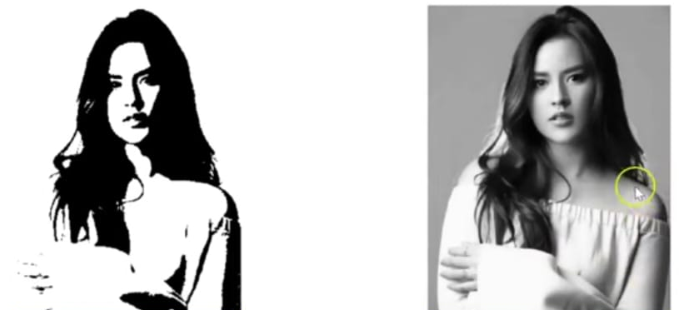
Fuzzy Logic
Fuzzy logic vs Boolean logic
Boolean Logic
Fuzzy Logic
The value only 0 and 1,
( black and white)
The value between 0 and 1,
( Grayscale)

Slide 6
Fuzzy Logic
Fuzzy logic fundamentals
Fuzzy Variable:
  variables that will be discussed in a fuzzy system
  Example: age, temperature, etc.
Fuzzy Set:
  a group that represents a certain state in a fuzzy variable
  Attribute Fuzzy Set:
    Linguistic: the name of a group that represents a certain situation using natural language
    Numeric

Slide 7
Fuzzy Logic
Fuzzy logic fundamentals
Fuzzy Universe:
  The overall value allowed to operate with fuzzy variables
  Example: Fuzzy Variable: age variable is [0, ∞]
The domain of a fuzzy set is all the values allowed in the universe of speech and can be operated on in a fuzzy set.

Slide 8
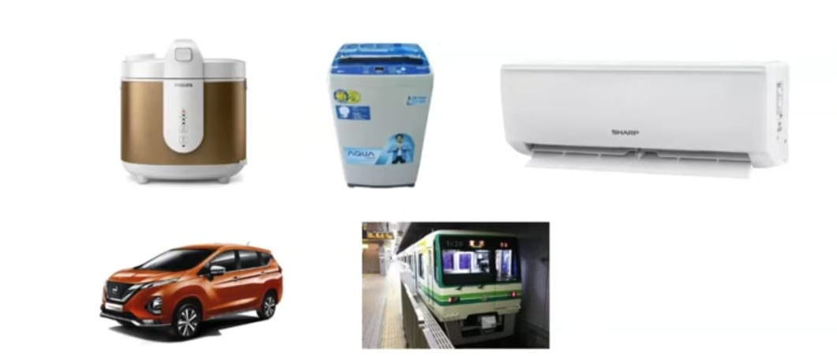
Fuzzy Logic
Fuzzy logic applications

Slide 9
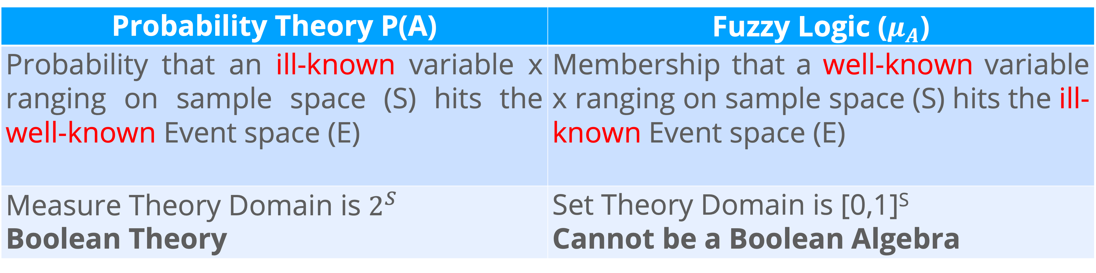
Fuzzy Logic
Fuzzy logic vs probability theory
Probability Theory P(A) | Fuzzy Logic ($μ_{A}$)
Probability that an ill-known variable x ranging on sample space (S) hits the well-known Event space (E) | Membership that a well-known variable x ranging on sample space (S) hits the ill-known Event space (E)
Measure Theory Domain is $2^{S}$ Boolean Theory | Set Theory Domain is [0,1]^{S} Cannot be a Boolean Algebra

Slide 10
Crisp set vs fuzzy set
Crisp set
Crisp Set is another way to say a set
In Crisp Set, the element of the set is 1 (element of the set) and 0 (not the element of the set)
However, the condition in the real world is not crisp. Most of the time, we defined the condition in ambiguous statement.
  For Example: enough sugar, cheap and etc.
Handling the ambiguous statement, we need to apply a threshold in pre-processing or post-processing step.

Slide 11
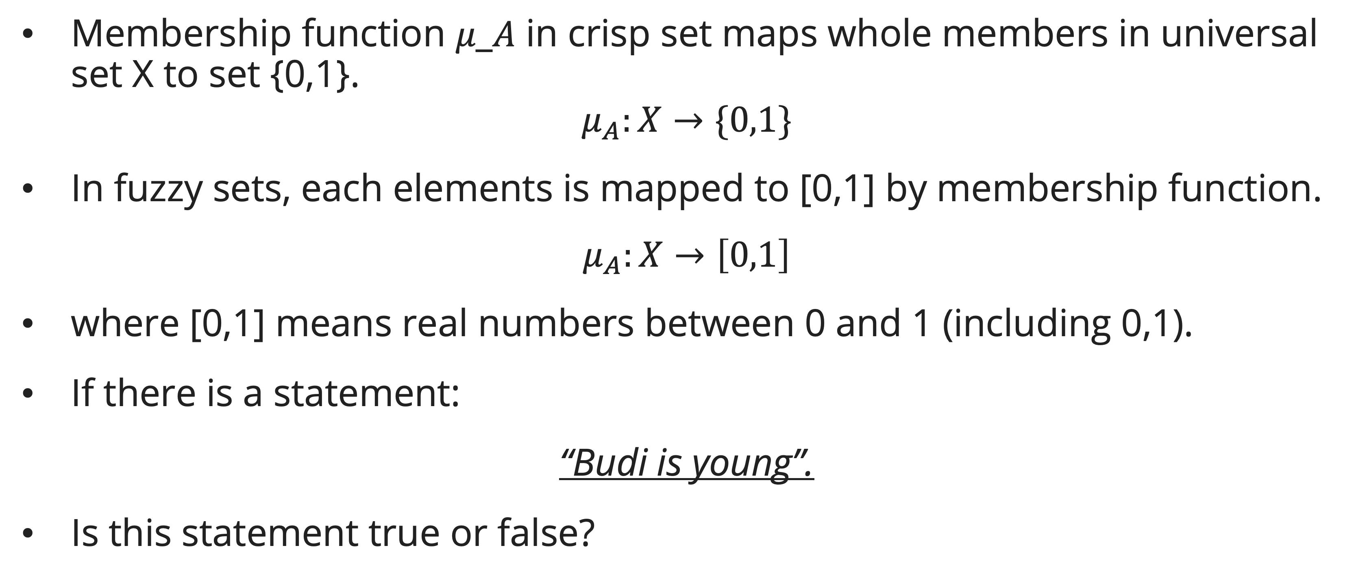
Crisp set vs fuzzy set
fuzzy set
Membership function 𝜇_𝐴 in crisp set maps whole members in universal set X to set {0,1}.
$$μ_{A}:X→\{0,1\}$$
In fuzzy sets, each elements is mapped to [0,1] by membership function.
$$μ_{A}:X→\left[0,1\right]$$
where [0,1] means real numbers between 0 and 1 (including 0,1).
If there is a statement:
“Budi is young”.
Is this statement true or false?

Slide 12
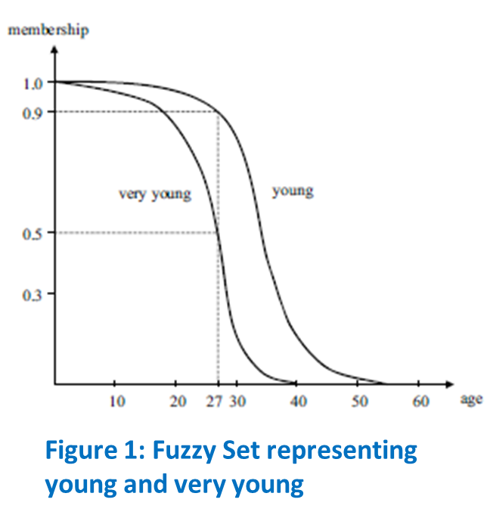
Crisp set vs fuzzy set
fuzzy set
Based on the previous example, the term "young" is ambiguous.
To represent the meaning of "ambiguous" accurately, it is necessary to define its membership function.
When we refer to "young," the age might lie in the range of [0,60]. We can consider these ages within this scope as a continuous set.

Slide 13
Crisp set vs fuzzy set
fuzzy set
If we follow the definition of "young" as shown in Figure 1, a ten-year-old boy may indeed be considered young
  The possibility for the "age of ten" to be included in the fuzzy set of "young" is 1.
  The likelihood for "age twenty-seven" is 0.9.
  However, we might not refer to a person who is over sixty as young, and the possibility in this case is 0.

Slide 14
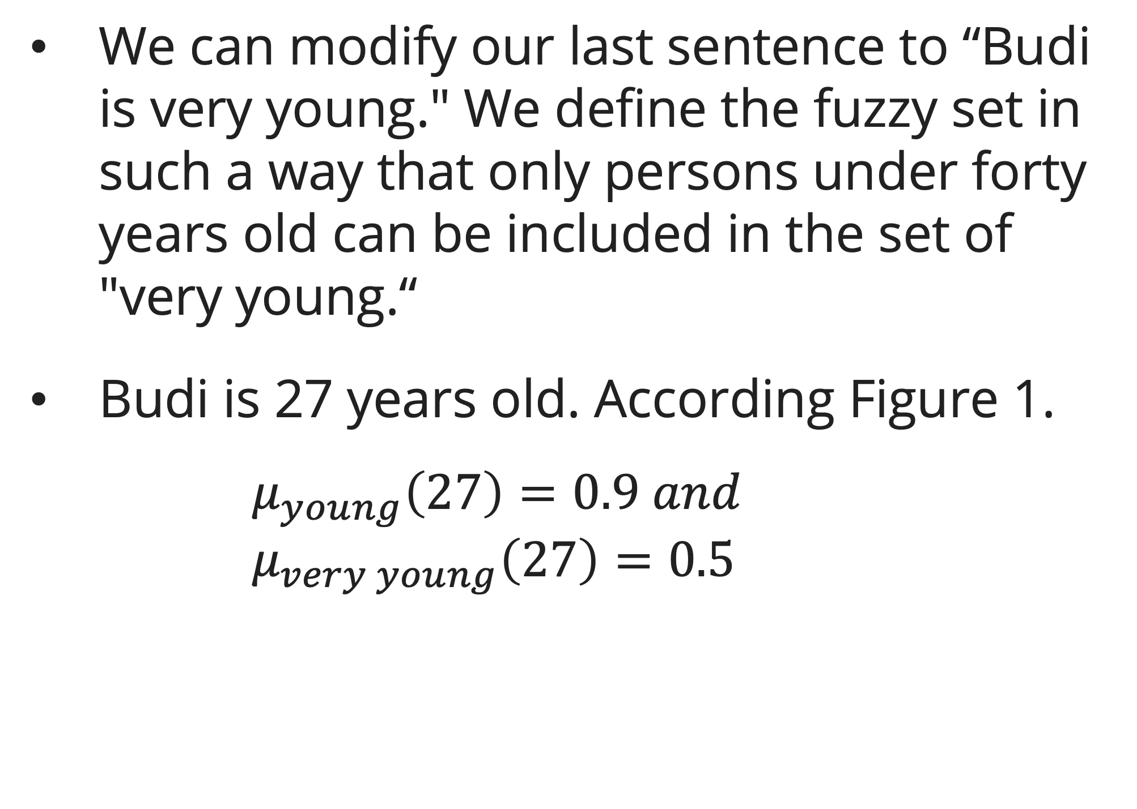
Crisp set vs fuzzy set
fuzzy set
We can modify our last sentence to “Budi is very young." We define the fuzzy set in such a way that only persons under forty years old can be included in the set of "very young.“
Budi is 27 years old. According Figure 1.
  $$μ_{young}\left(27\right)=0.9 and \\ μ_{very young}\left(27\right)=0.5$$

Slide 15
Crisp set vs fuzzy set
fuzzy set advantages
  Store and Process the hidden information
    Assume we have two mathematician
    In Crisp set, both have same ability
    In Fuzzy set, each of them have different ability
  Useful for soft-clustering and soft classification

Slide 16
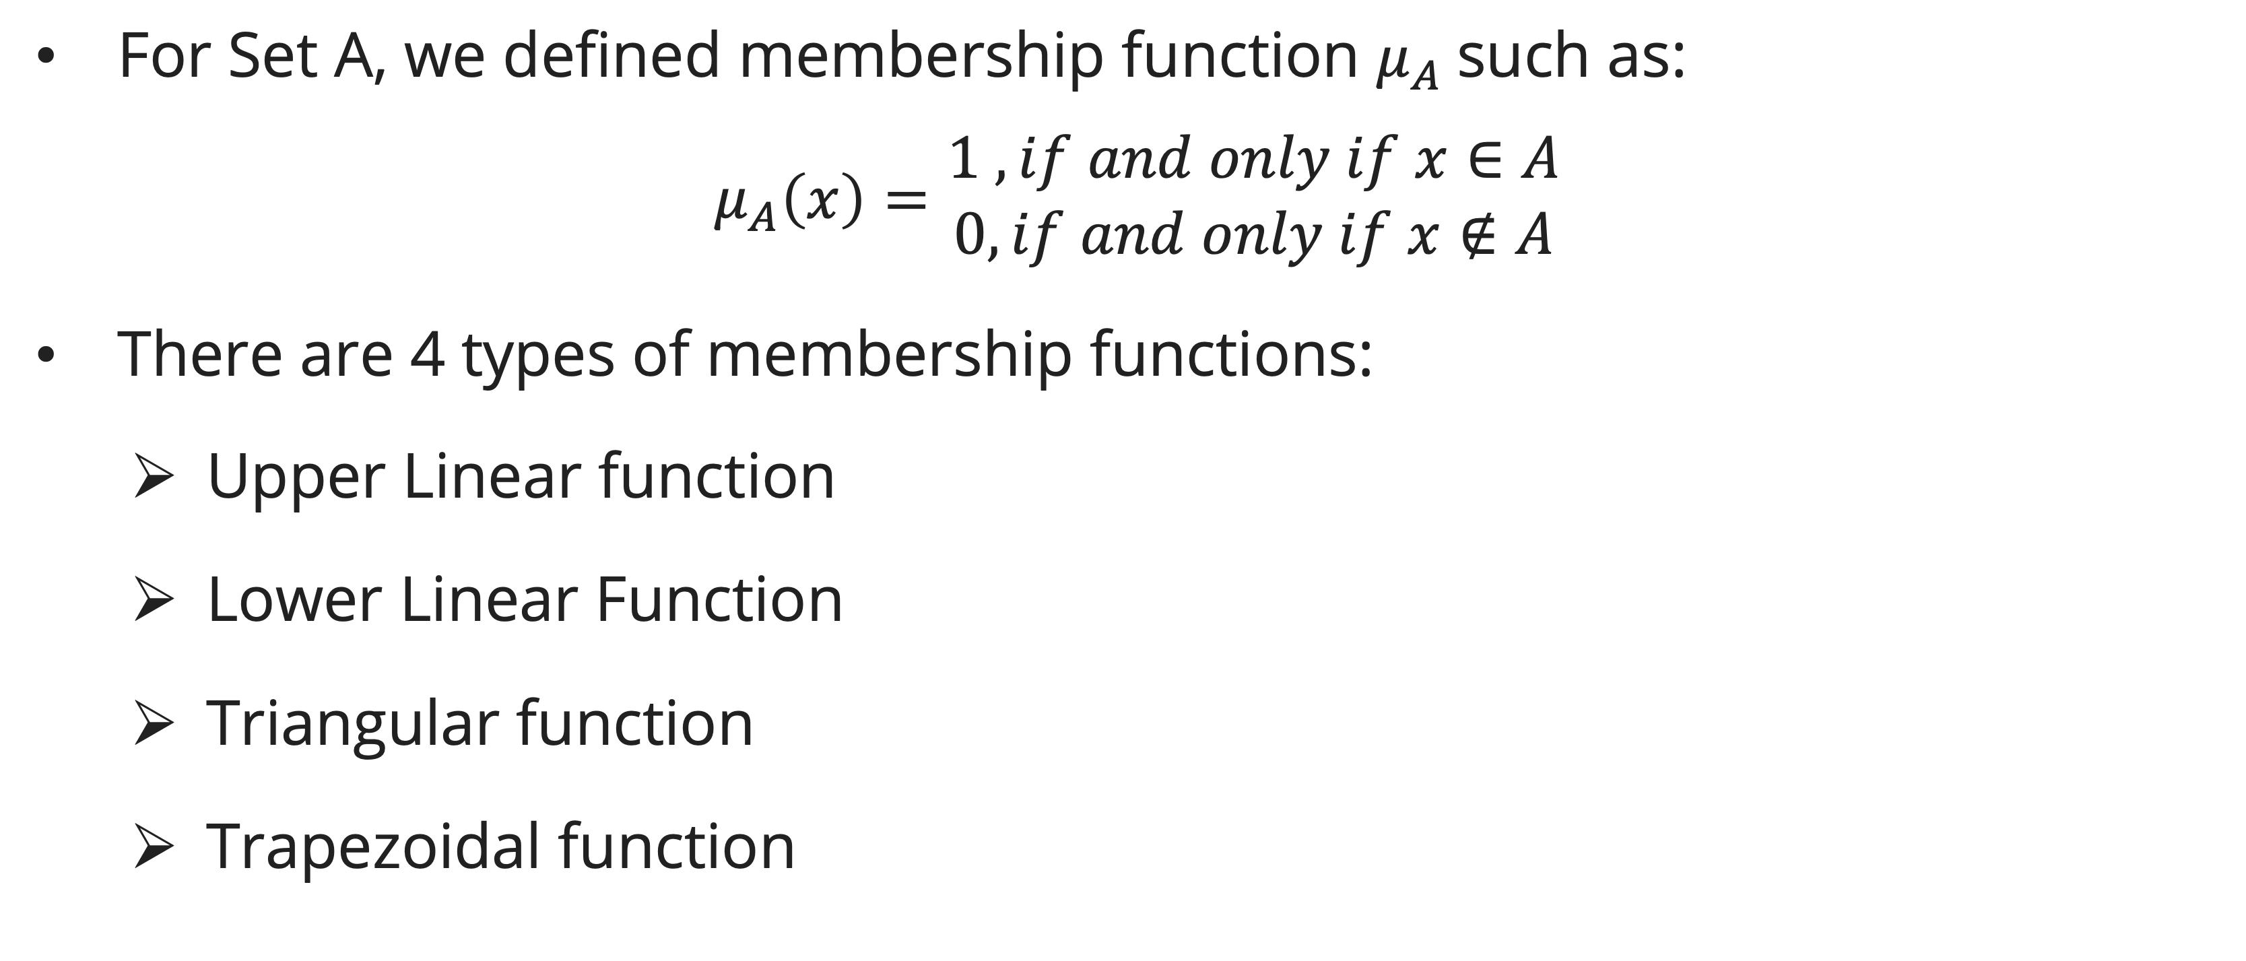
Membership function
Definition
For Set A, we defined membership function $μ_{A}$such as:
$$μ_{A}\left(x\right)=\begin{matrix}1 , if and only if x∈A \\ 0, if and only if x∉A\end{matrix}$$
There are 4 types of membership functions:
Upper Linear function
Lower Linear Function
Triangular function
Trapezoidal function

Slide 17

Membership function
Upper linear membership function
1.0
a
b

Slide 18

Membership function
lower linear membership function
1.0
a
b

Slide 19
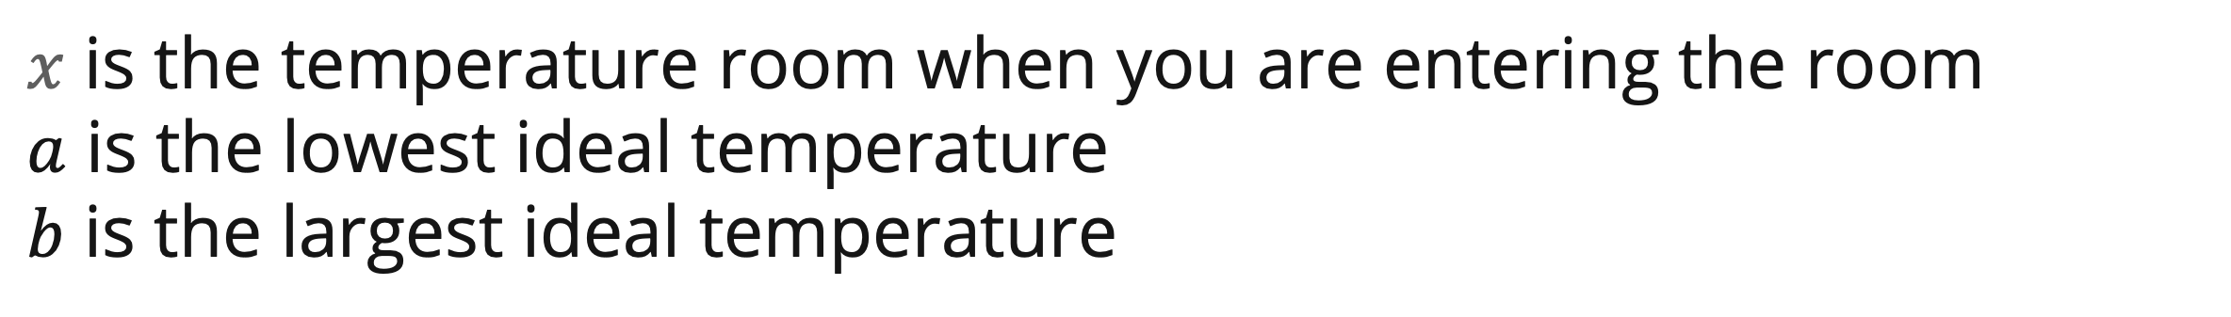
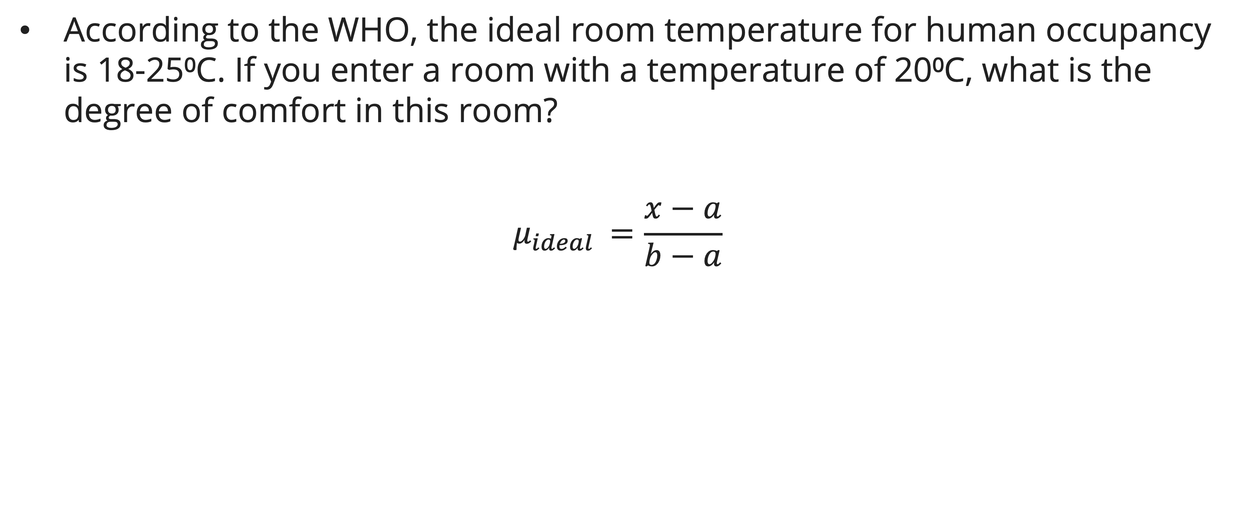
Membership function
Example: linear membership function
According to the WHO, the ideal room temperature for human occupancy is 18-25⁰C. If you enter a room with a temperature of 20⁰C, what is the degree of comfort in this room?
$$μ_{ideal }=\frac{x−a}{b−a}$$
$x$ is the temperature room when you are entering the room
$a$ is the lowest ideal temperature
$b$ is the largest ideal temperature

Slide 20
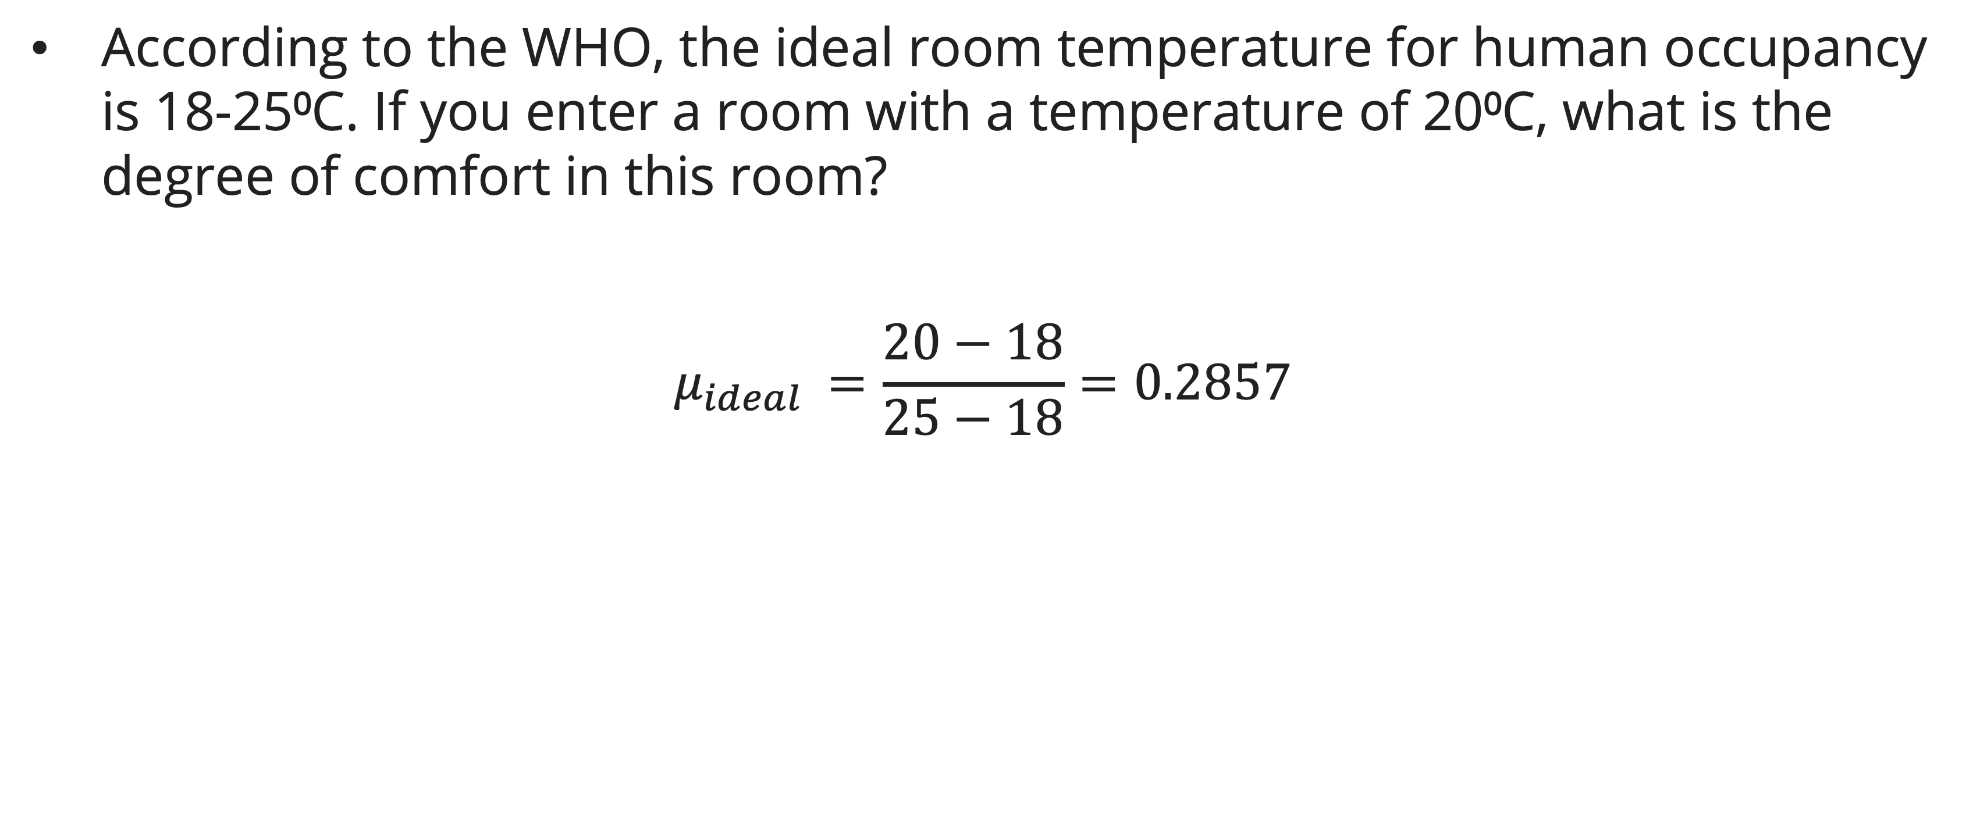
Membership function
Example: linear membership function
According to the WHO, the ideal room temperature for human occupancy is 18-25⁰C. If you enter a room with a temperature of 20⁰C, what is the degree of comfort in this room?
$$μ_{ideal }=\frac{20−18}{25−18}=0.2857$$
$x$ is the temperature room when you are entering the room
$a$ is the lowest ideal temperature
$b$ is the largest ideal temperature

Slide 21
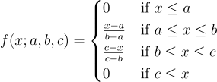
Membership function
Triangular membership function

Slide 22
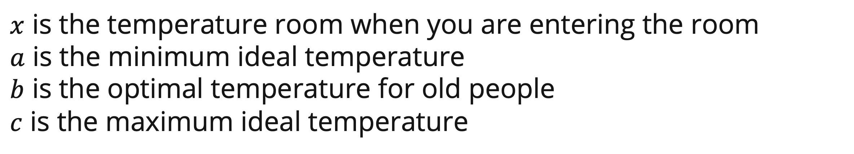
Membership function
Example: triangular membership function
According to the WHO, the ideal room temperature for human occupancy is 18-25⁰C, with 20⁰C being the most ideal for older people. An old woman enters a room with a temperature of 22⁰C. What is the degree of comfort in this room for the old woman?
$x$ is the temperature room when you are entering the room
$a$ is the minimum ideal temperature
$b$ is the optimal temperature for old people
$c$ is the maximum ideal temperature

Slide 23
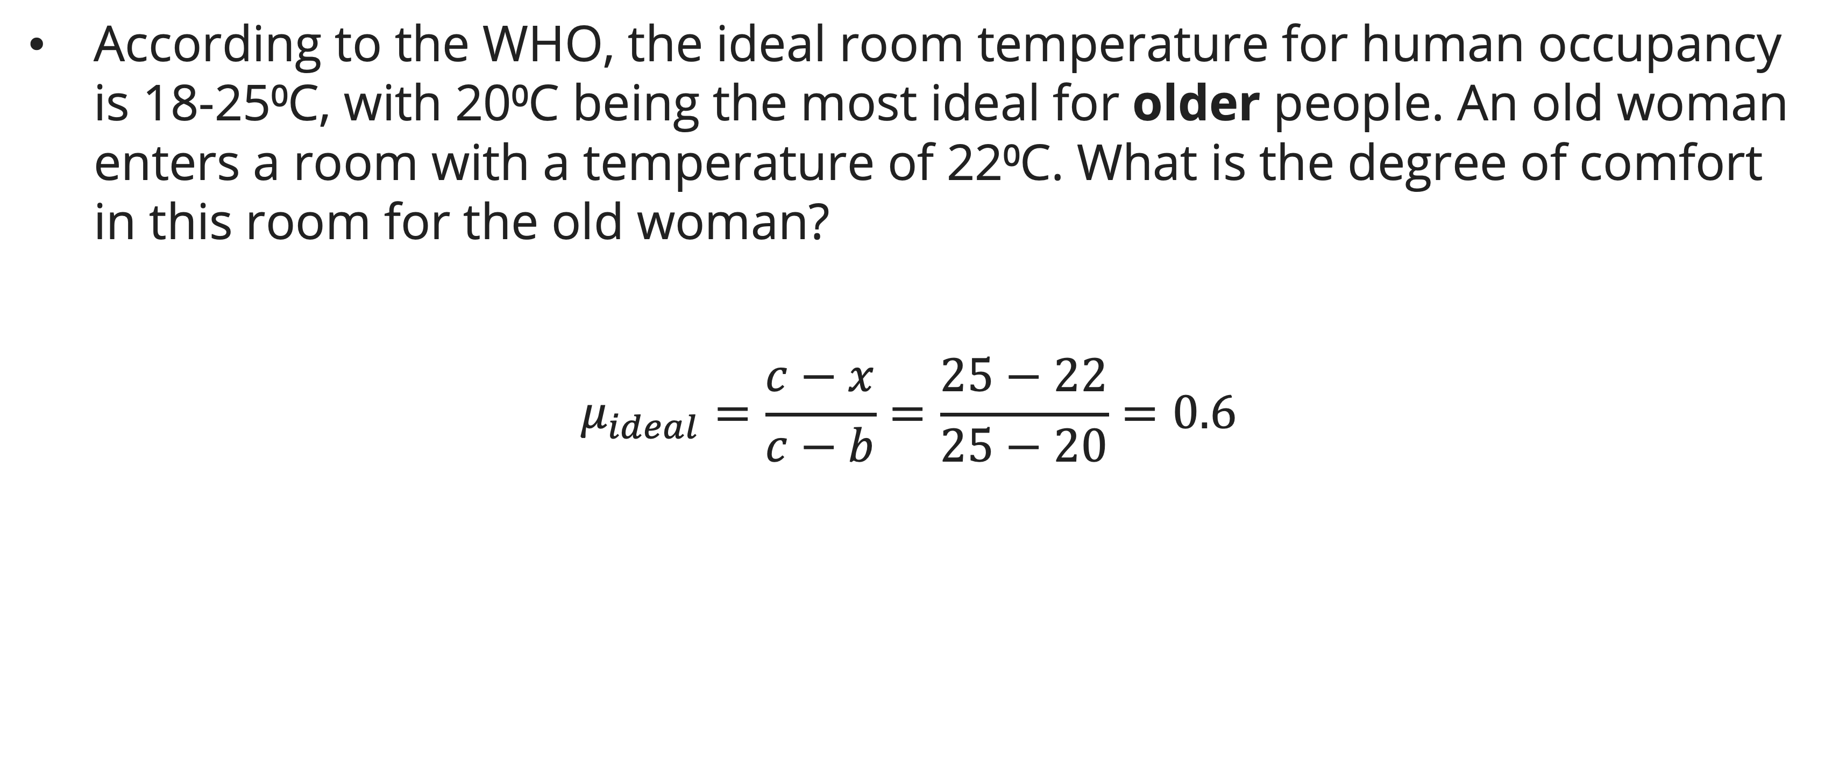
Membership function
Example: triangular membership function
According to the WHO, the ideal room temperature for human occupancy is 18-25⁰C, with 20⁰C being the most ideal for older people. An old woman enters a room with a temperature of 22⁰C. What is the degree of comfort in this room for the old woman?
$$μ_{ideal}=\frac{c−x}{c−b}=\frac{25−22}{25−20}=0.6$$
$x$ is the temperature room when you are entering the room
$a$ is the minimum ideal temperature
$b$ is the optimal temperature for old people
$c$ is the maximum ideal temperature

Slide 24
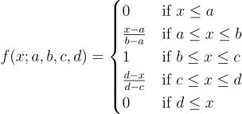
Membership function
Trapezoid membership function

Slide 25

Membership function
Example: triangular membership function
According to the WHO, the ideal room temperature for human occupancy is 18-25⁰C. The ideal temperature for an infant is 20-21⁰C. An infant sleeps in a room with a temperature of 22⁰C. What is the degree of comfort for this infant in this room?
$x$ is the temperature room when you are entering the room
$a$ is the minimum ideal temperature
$b,c$ is the optimal temperature for old people
$d$ is the maximum ideal temperature

Slide 26
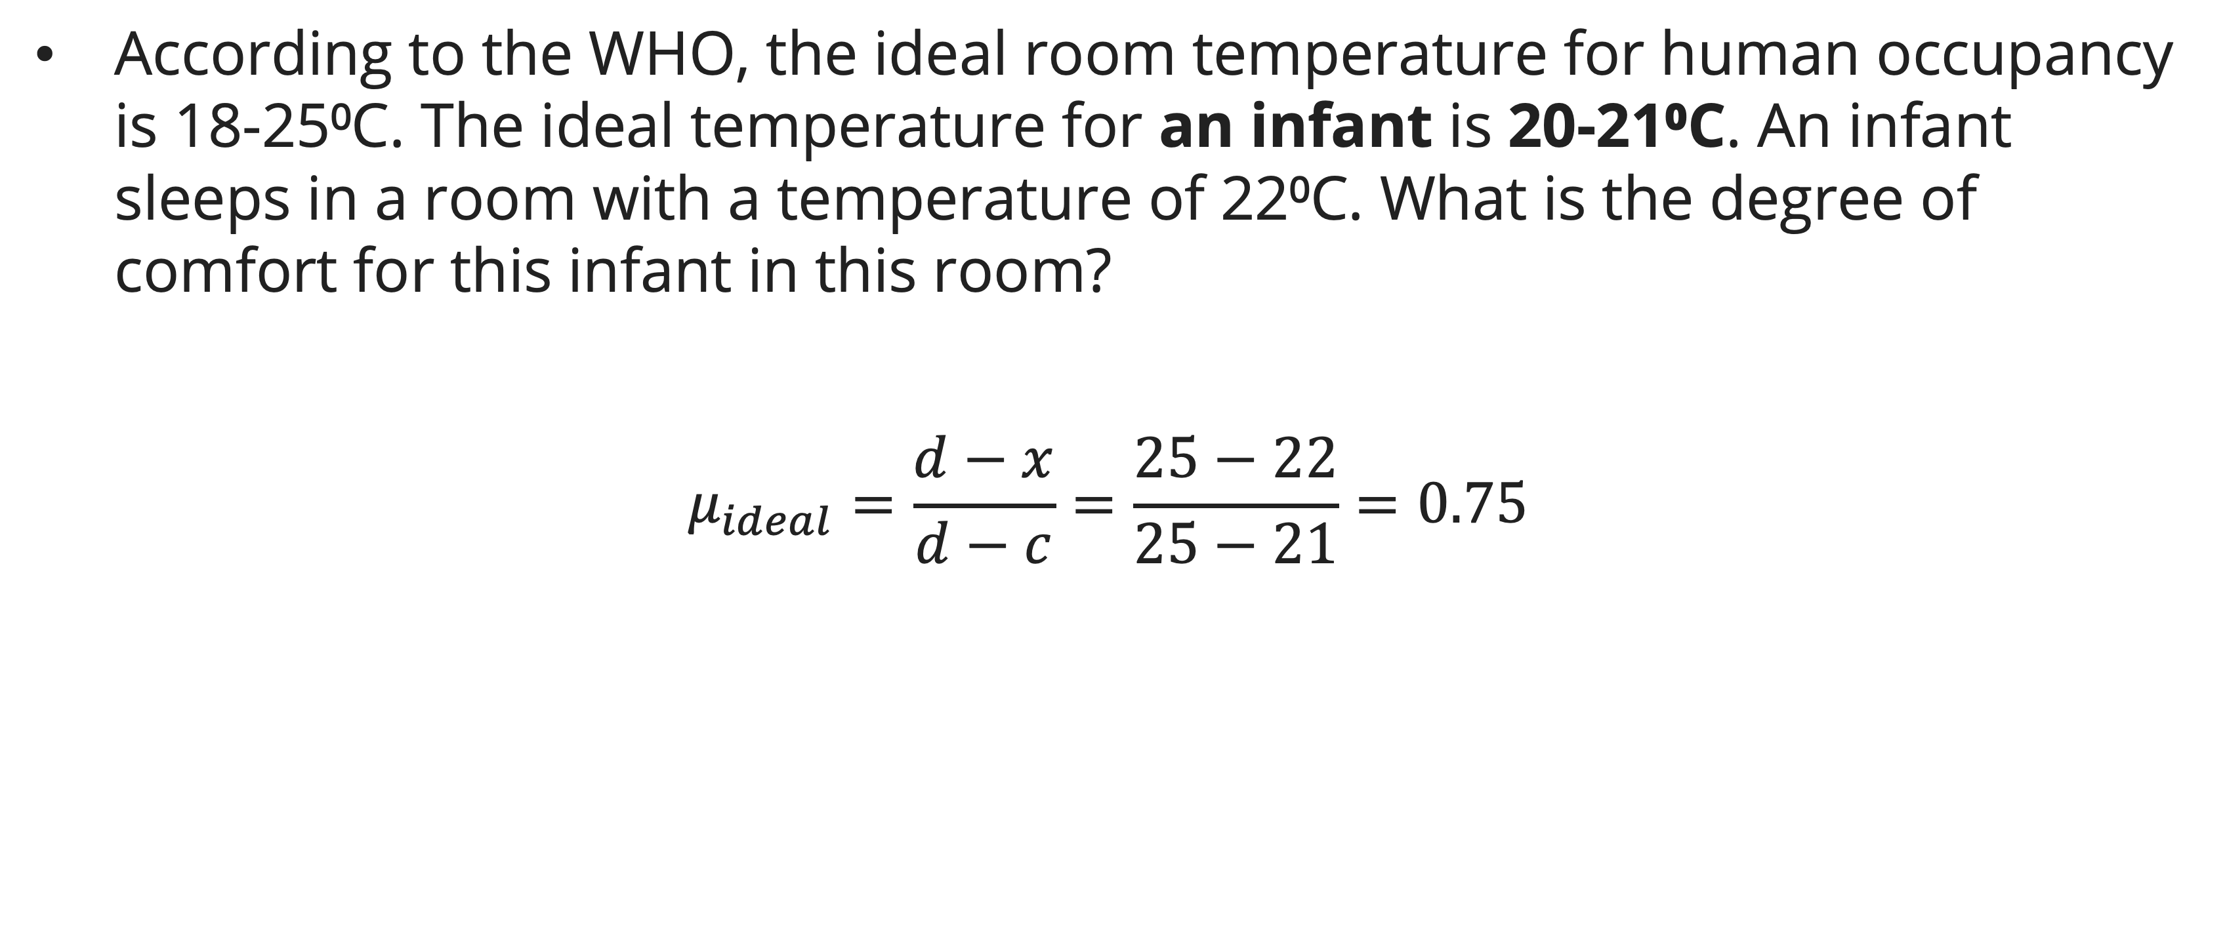
Membership function
Example: triangular membership function
According to the WHO, the ideal room temperature for human occupancy is 18-25⁰C. The ideal temperature for an infant is 20-21⁰C. An infant sleeps in a room with a temperature of 22⁰C. What is the degree of comfort for this infant in this room?
$$μ_{ideal}=\frac{d−x}{d−c}=\frac{25−22}{25−21}=0.75$$
$x$ is the temperature room when you are entering the room
$a$ is the minimum ideal temperature
$b,c$ is the optimal temperature for old people
$d$ is the maximum ideal temperature

Slide 27
Membership function
How to make a membership function
Interview those who are familiar with the underlying concept and later adjust it based on a tuning strategy
Construct it automatically from data.
Learn it based on feedback from the system performance

Slide 28

Standard operation of fuzzy set
Type of operation
Complement
$$μ_{\overline{A}}=1−μ_{A}$$
Union (or)
$$μ_{A⋃B}=MAX[μ_{A}\left(x\right),μ_{B}\left(x\right)]$$
Intersection (and)
$$μ_{A∩B}=MIN[μ_{A}\left(x\right),μ_{B}\left(x\right)]$$

Slide 29
Exercise
According to some research, the normal temperature for place X ranges from 24°C to 27°C. Temperatures lower than 15°C are considered cold, while those higher than 32°C are considered hot.
  Draw the membership function
  One day, the temperature of that area are 23 C. Calculate the degree of comfortability according to the previous membership function.

Slide 30
References
Session 15
Engelbrecht, A. P. (2023). Computational intelligence: an introduction 3rd edition. Wiley
Lee, K. H. (2004). First course on Fuzzy Theory and Applications. Springer Science & Business Media.

